Slide 1
13. Image editing with text
2022-06-04
kts123@kookmin.ac.kr

Slide 2
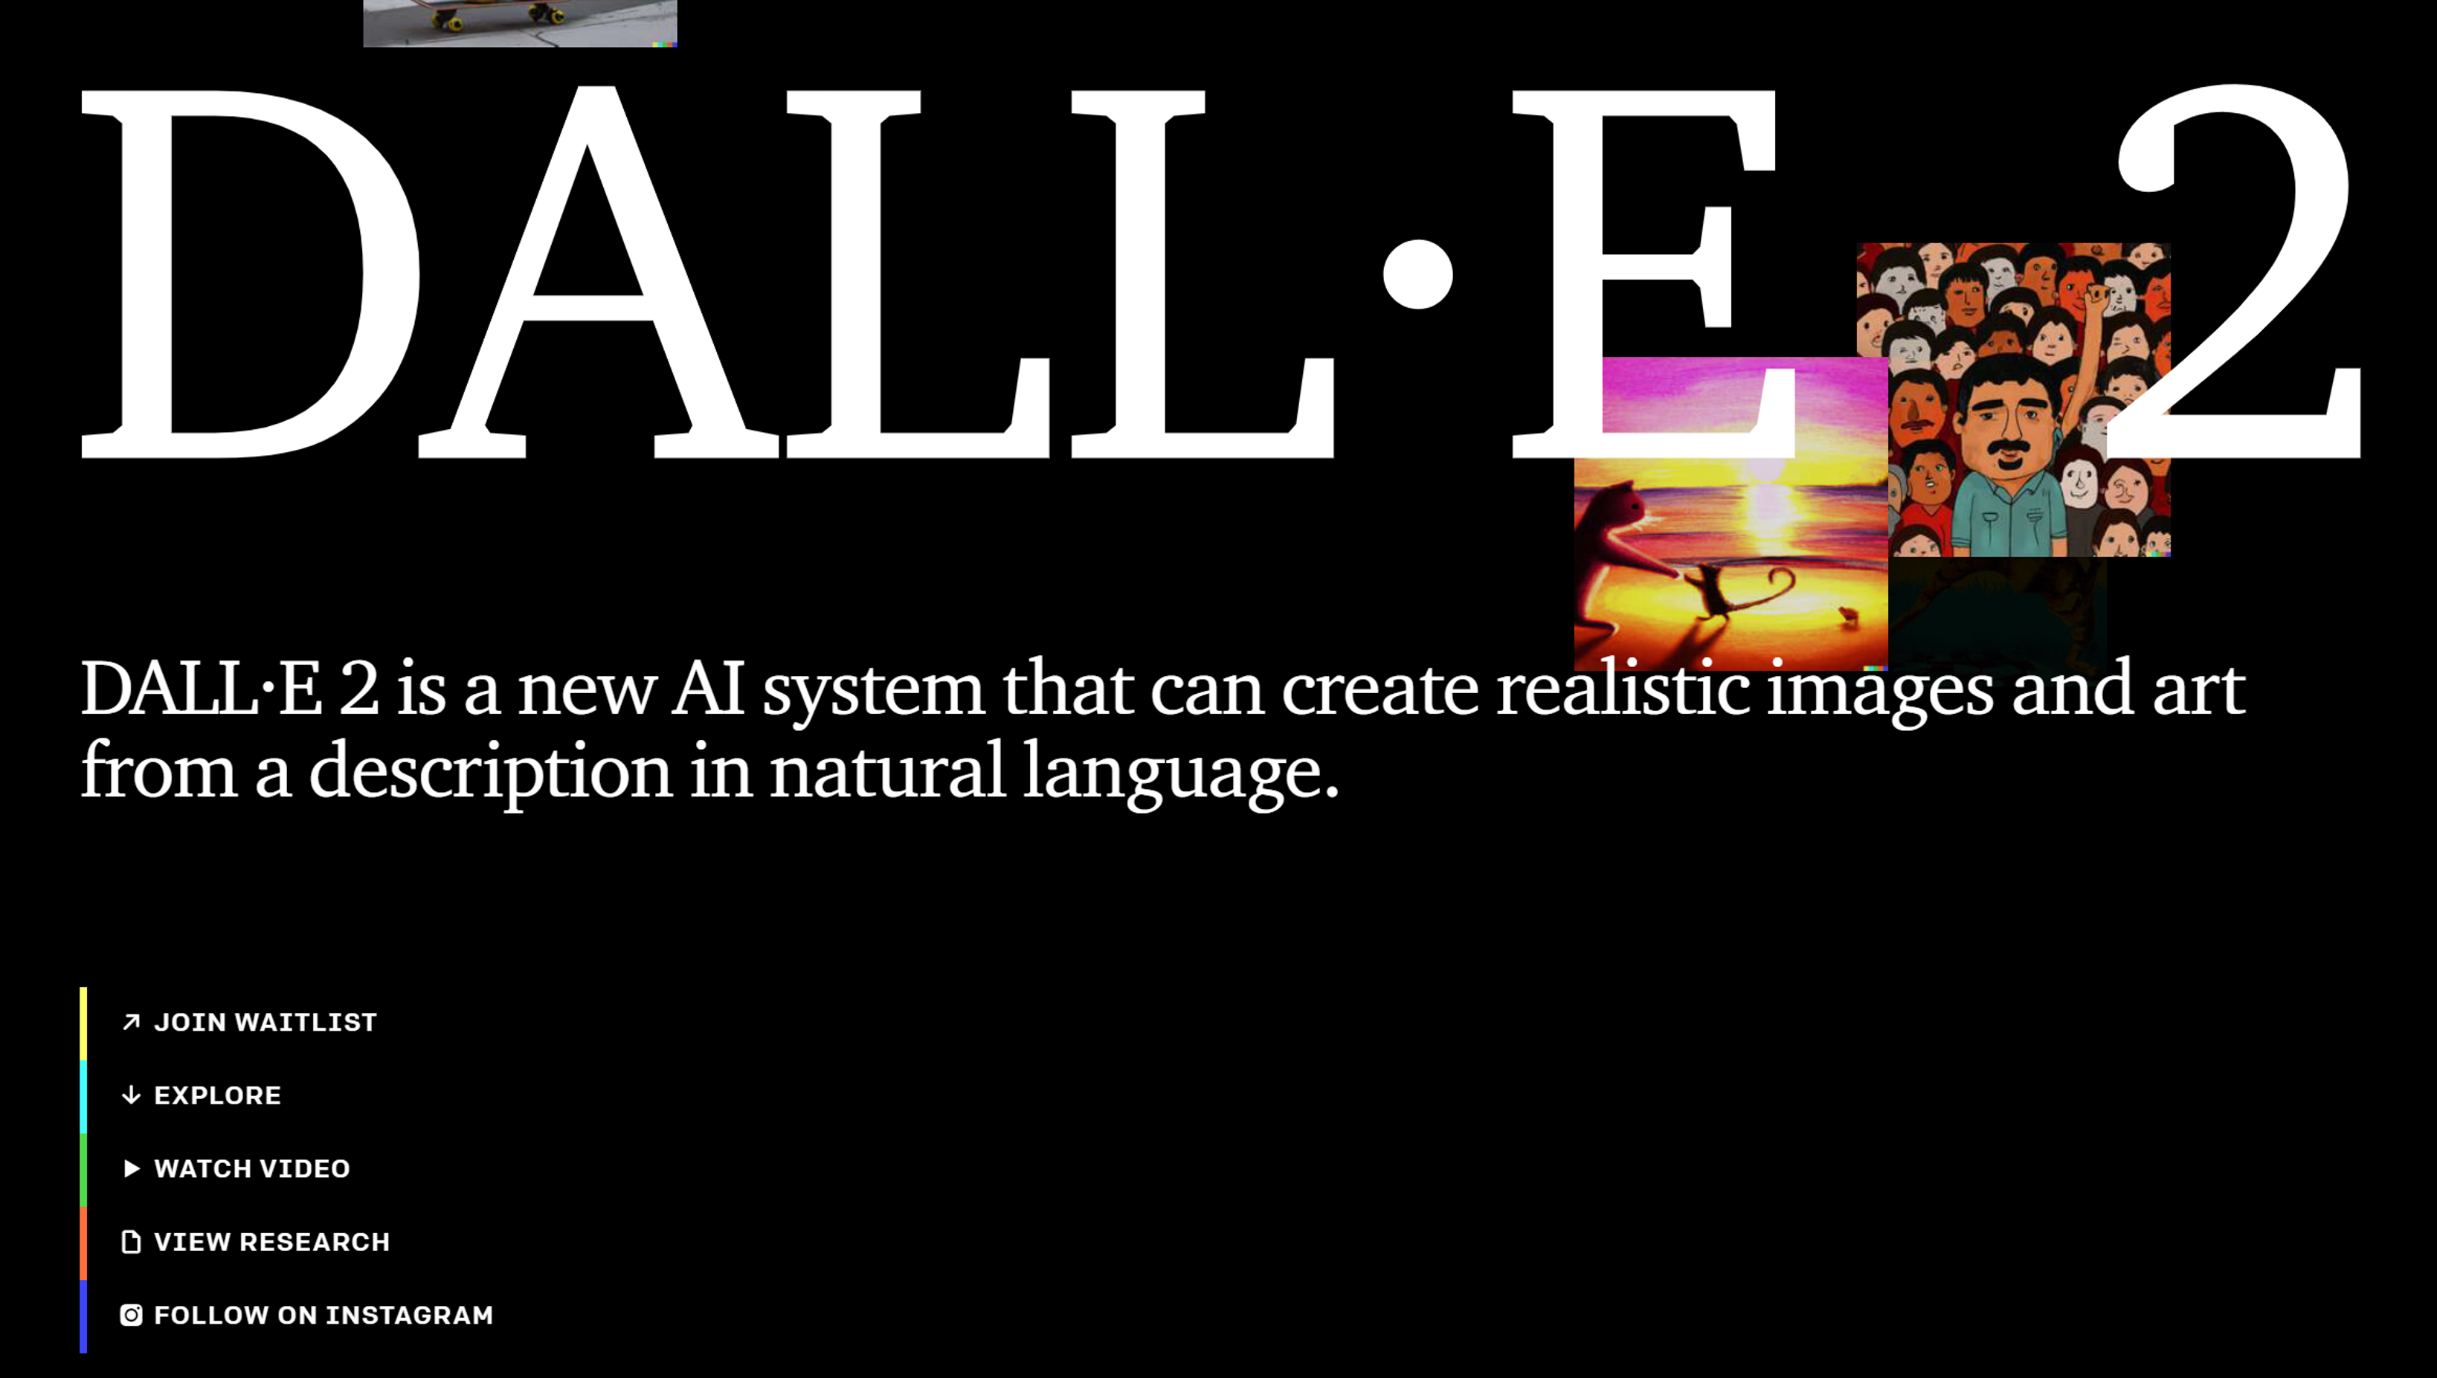
https://openai.com/dall-e-2/

Slide 3
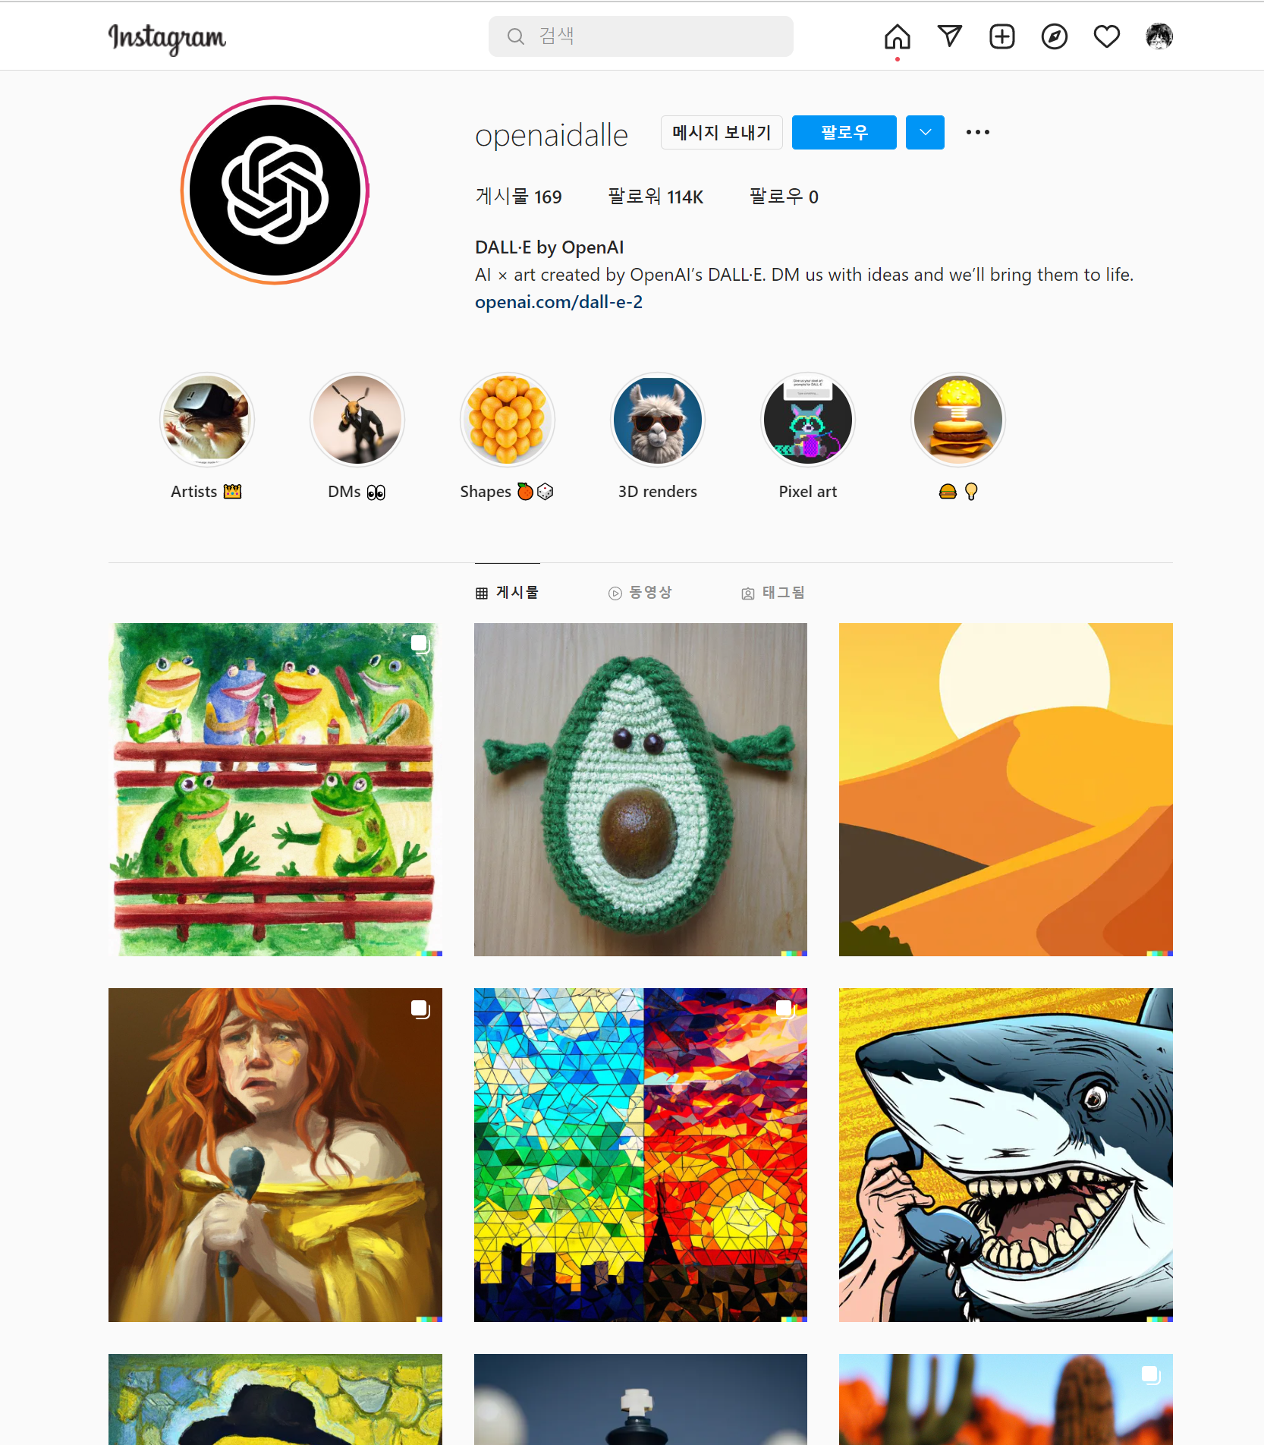
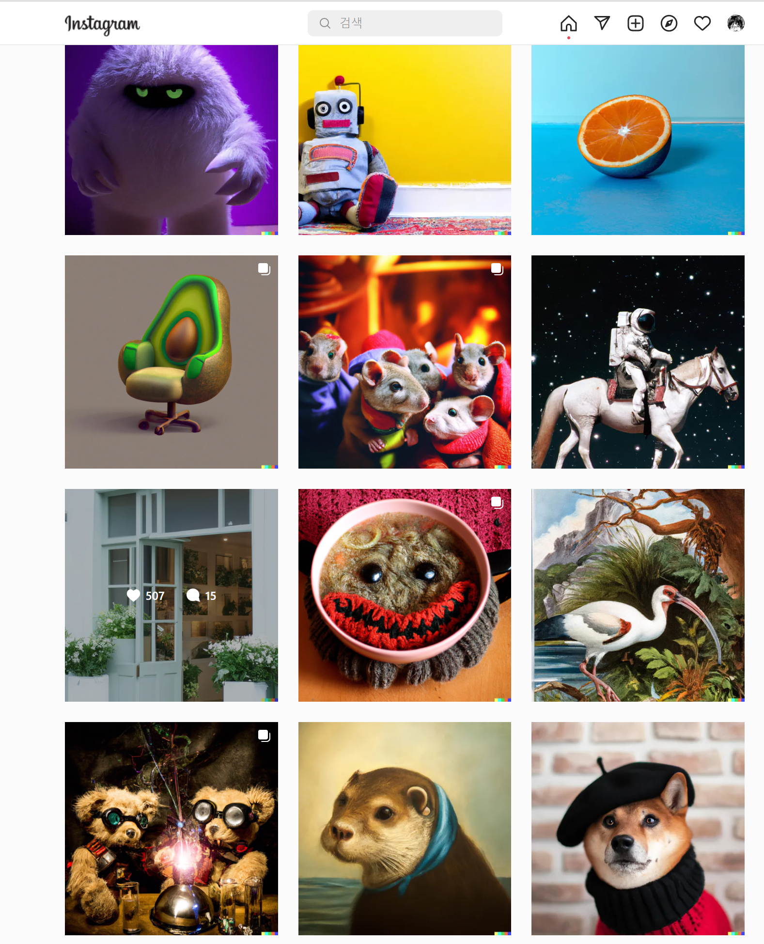
https://www.instagram.com/openaidalle/

Slide 4
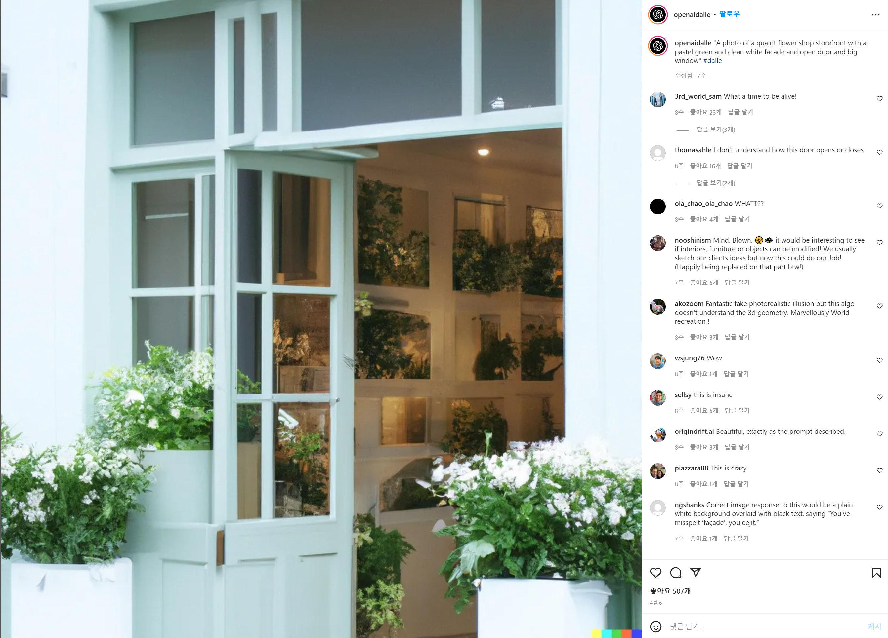
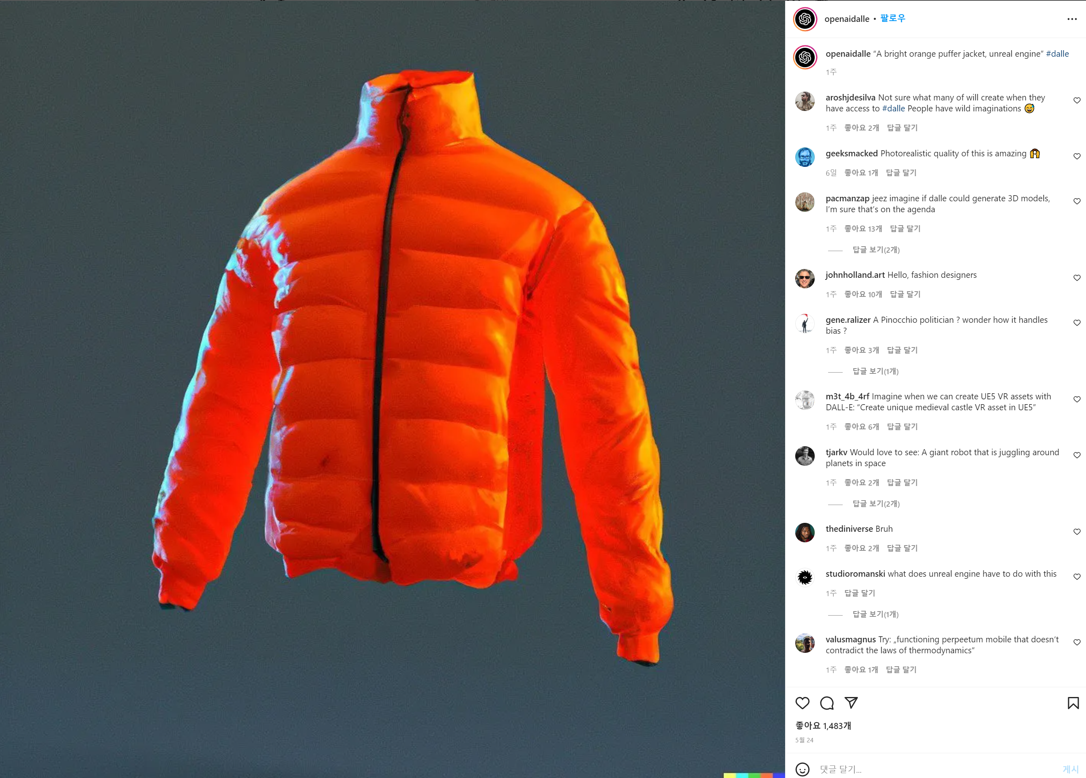
"A photo of a quaint flower shop storefront with a pastel green and clean white facade and open door and big window"
“A bright orange puffer jacket, unreal engine”
https://www.instagram.com/openaidalle/

Slide 5
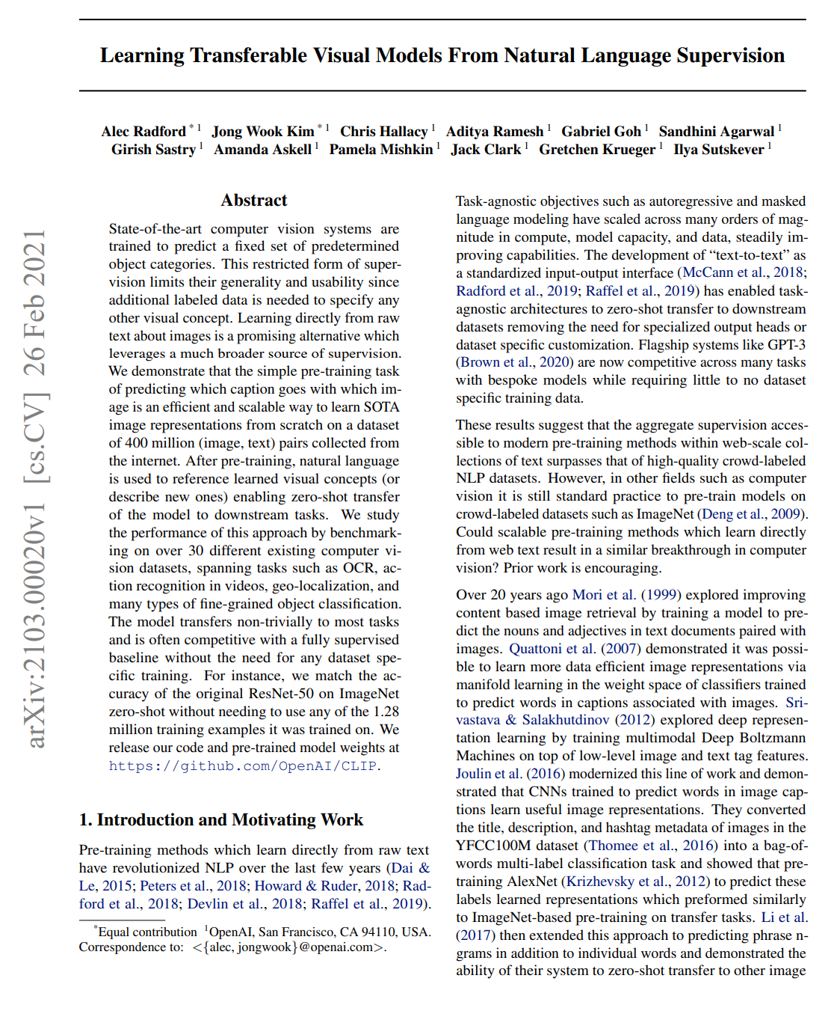
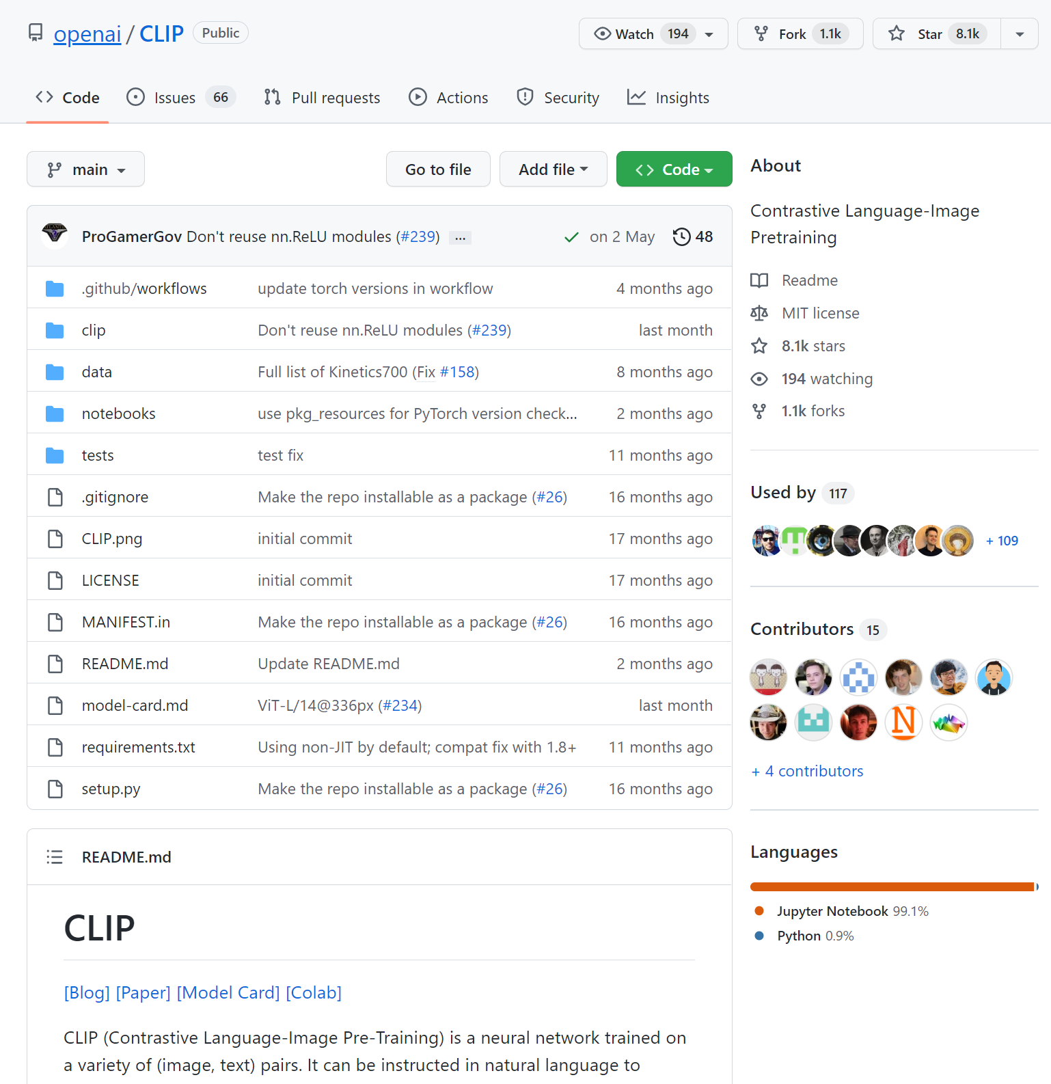
CLIP (Contrastive Language-Image Pre-Training)
https://arxiv.org/pdf/2103.00020.pdf
https://github.com/openai/CLIP

Slide 6
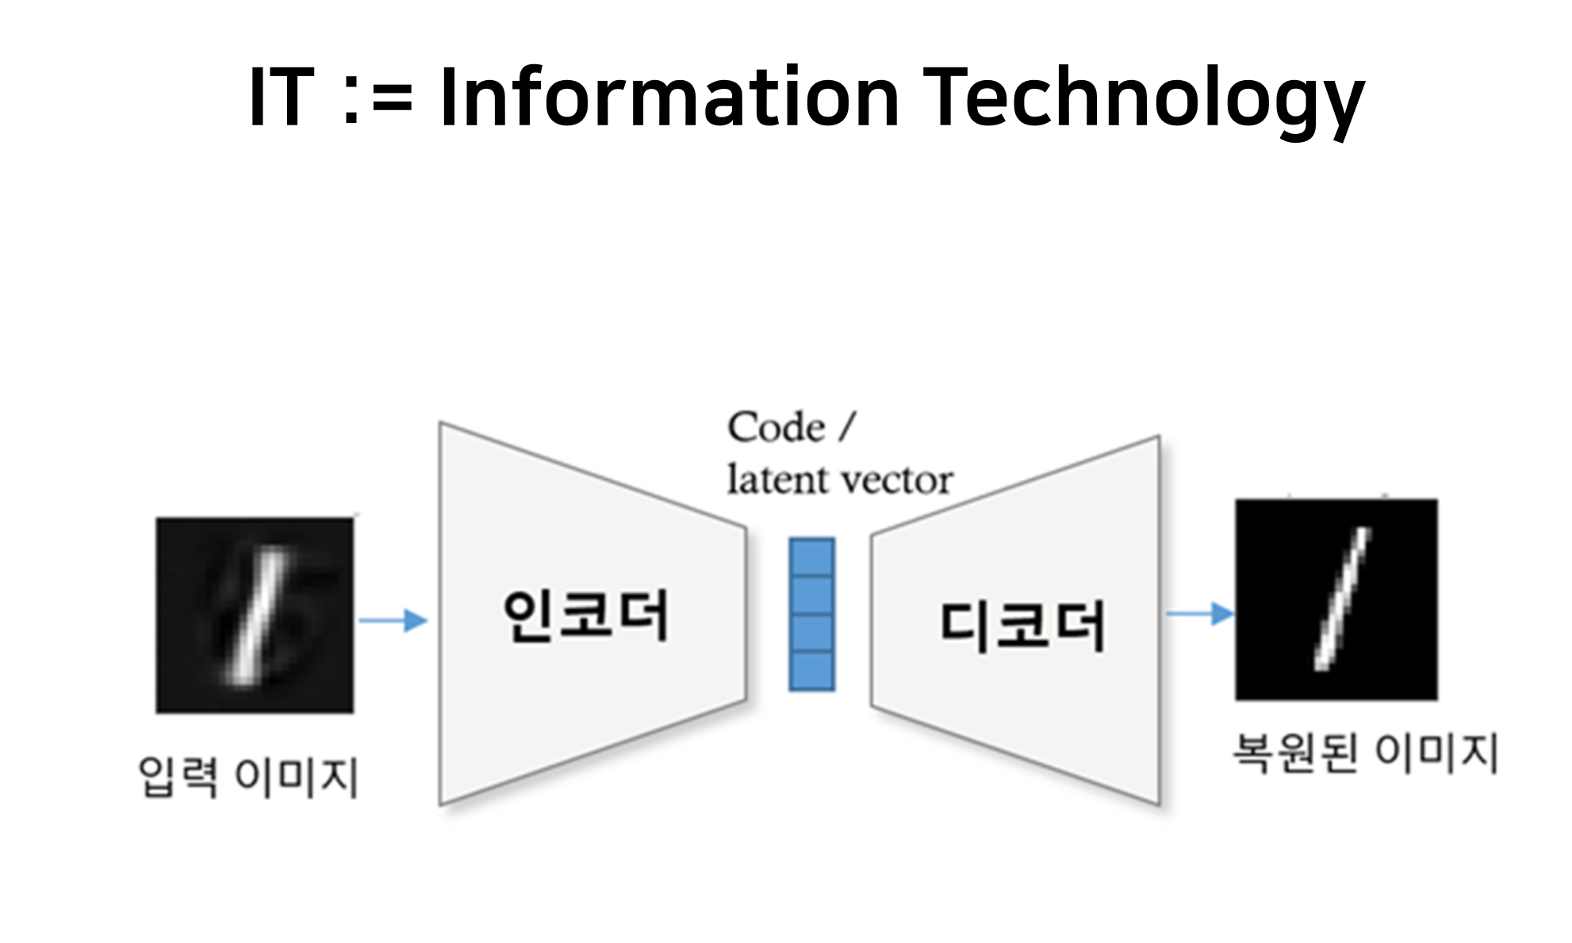
Remind: Autoencoder

Slide 7
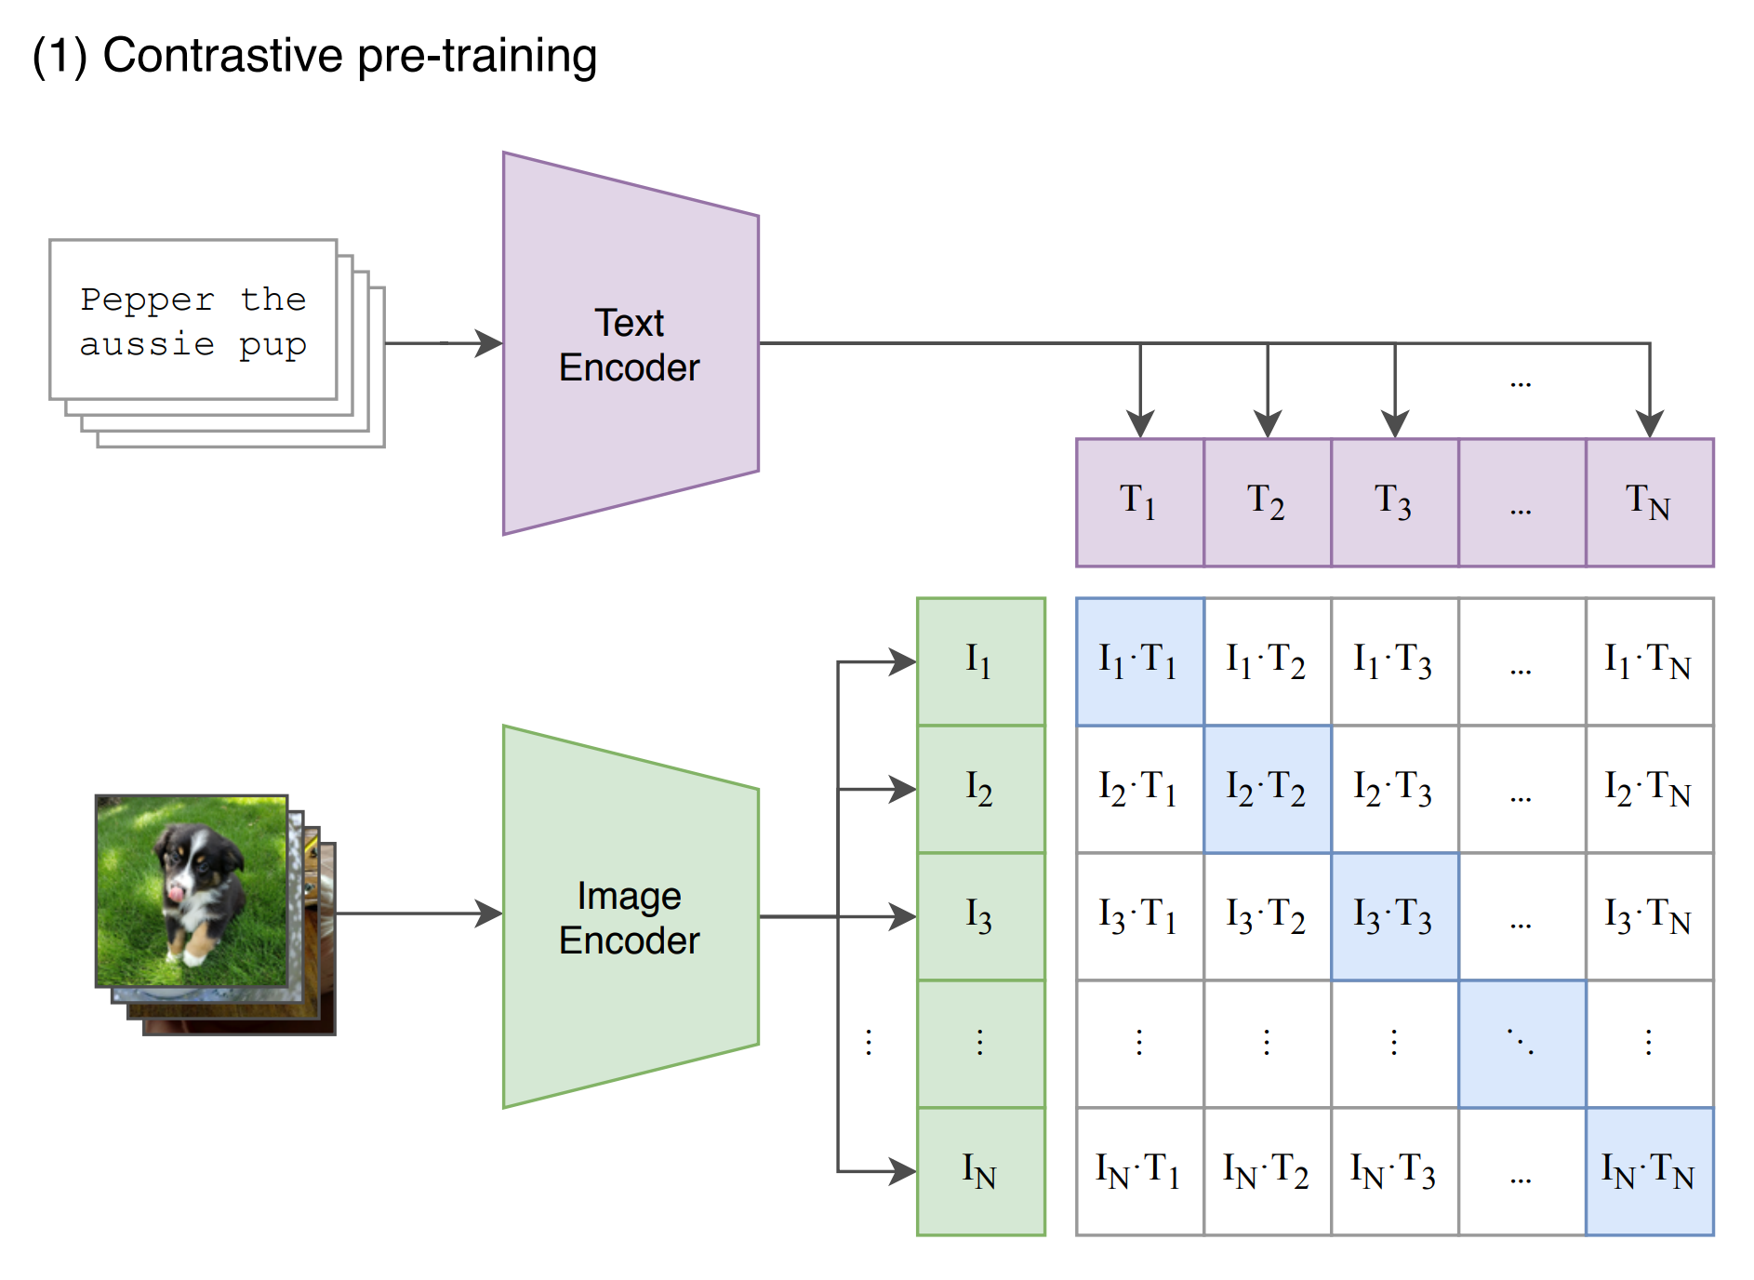

Slide 8
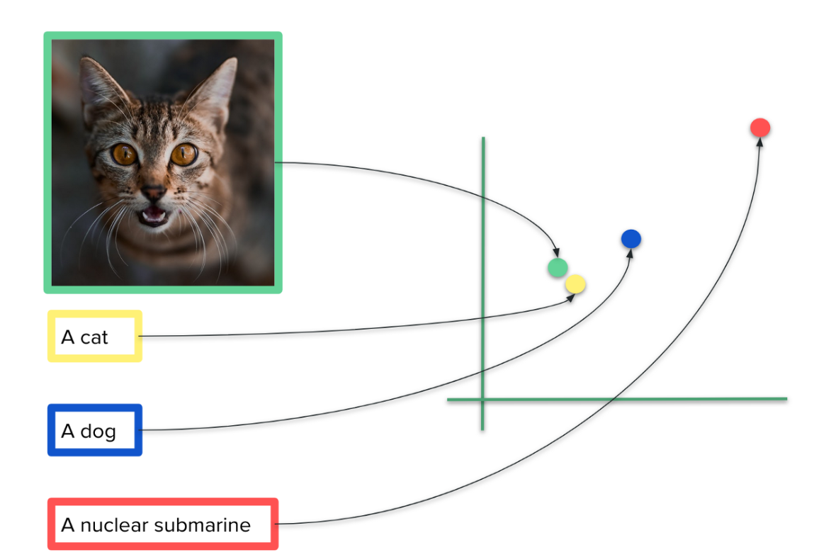
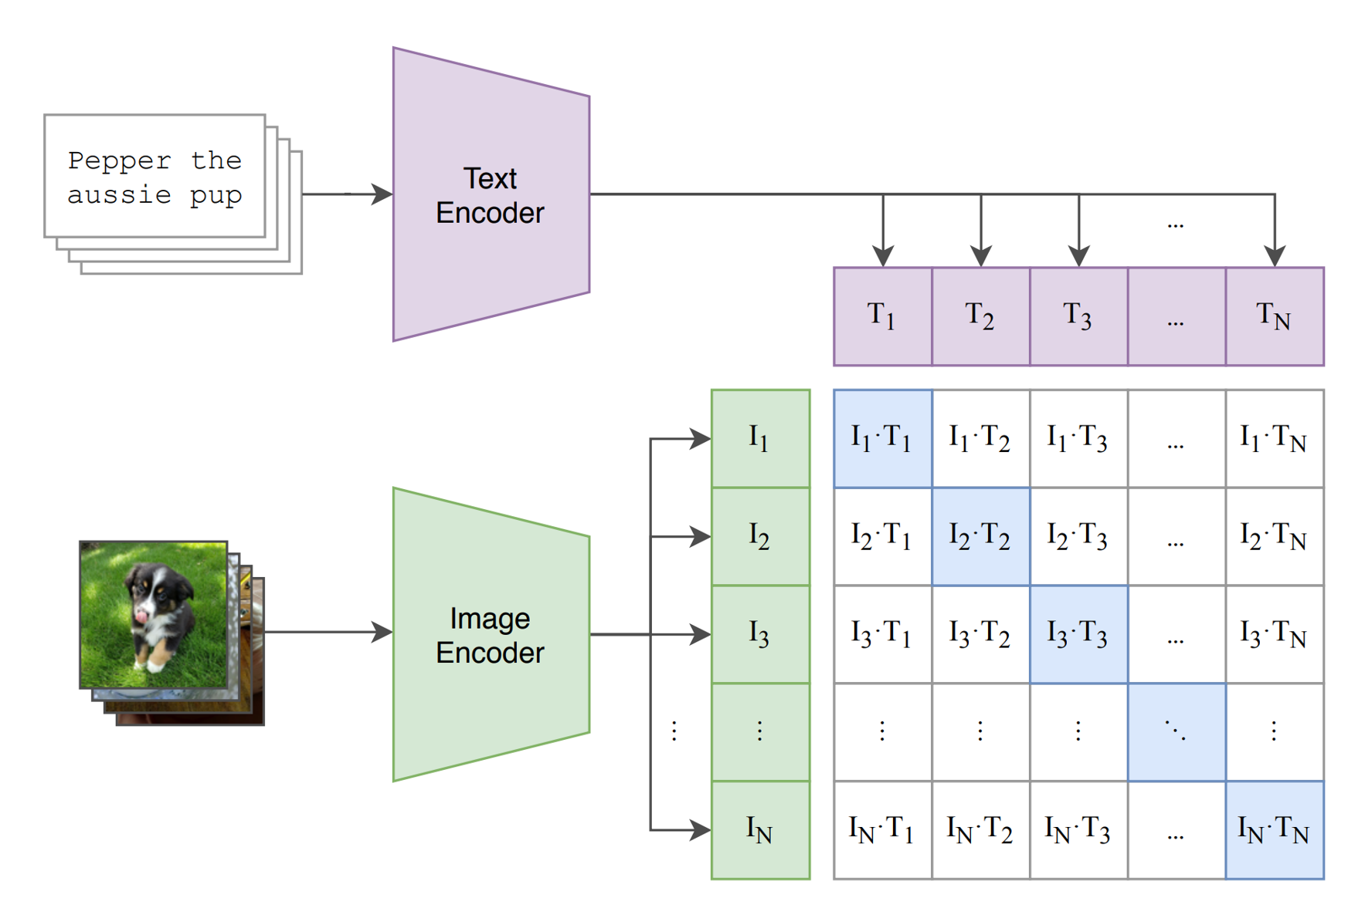
https://towardsdatascience.com/how-to-train-your-clip-45a451dcd303

Slide 9
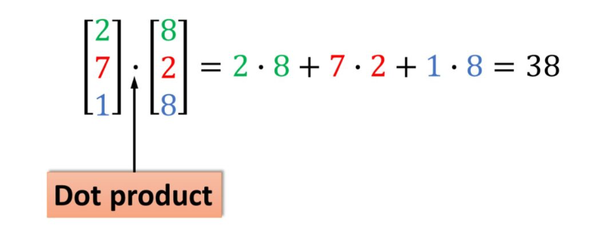
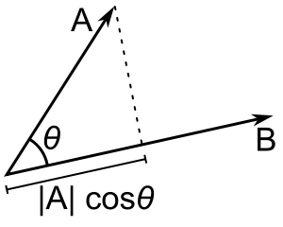

Slide 10
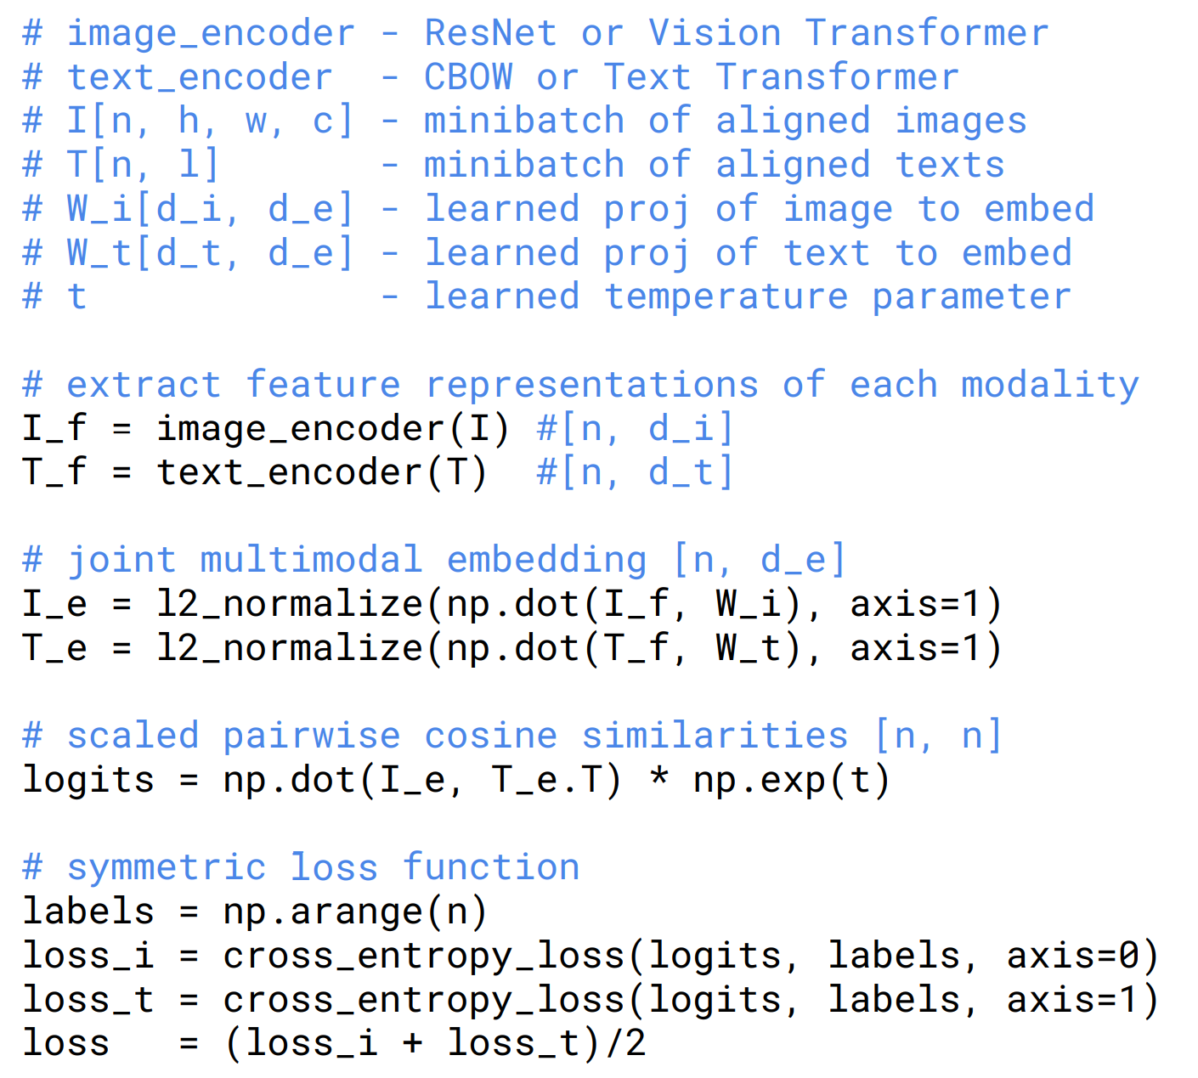

Slide 11
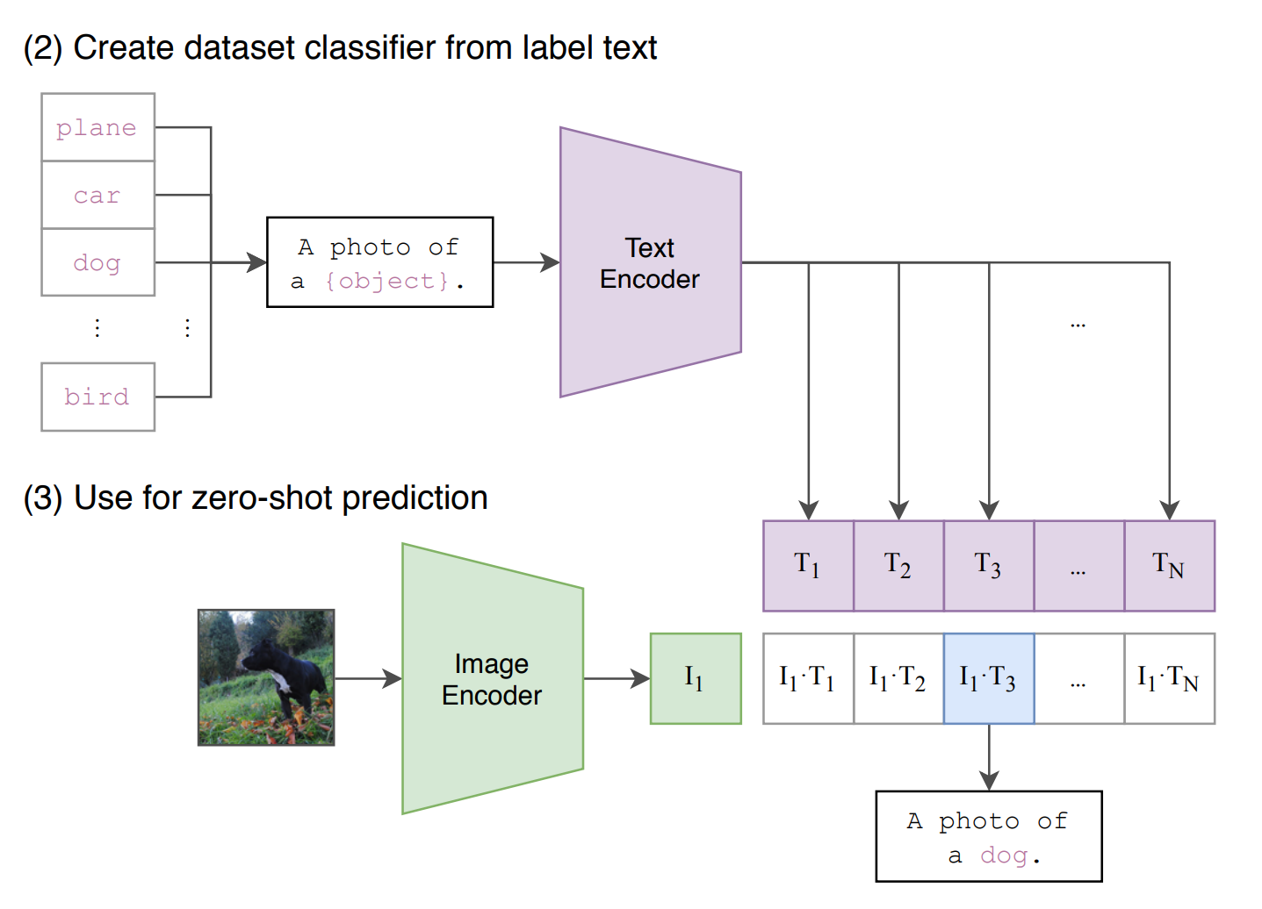

Slide 12
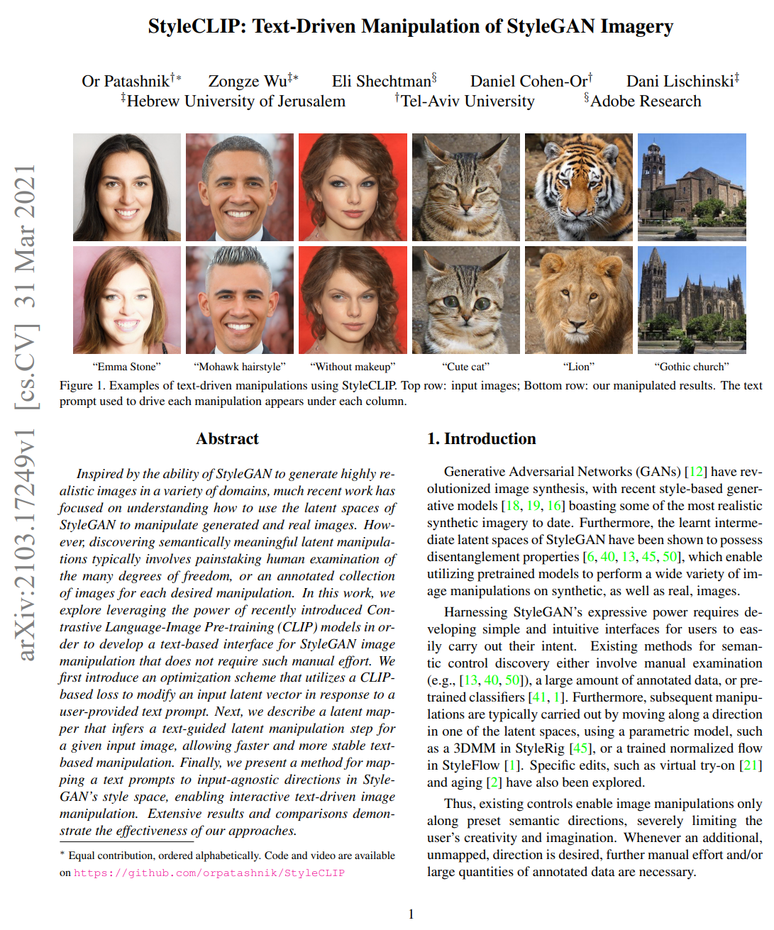
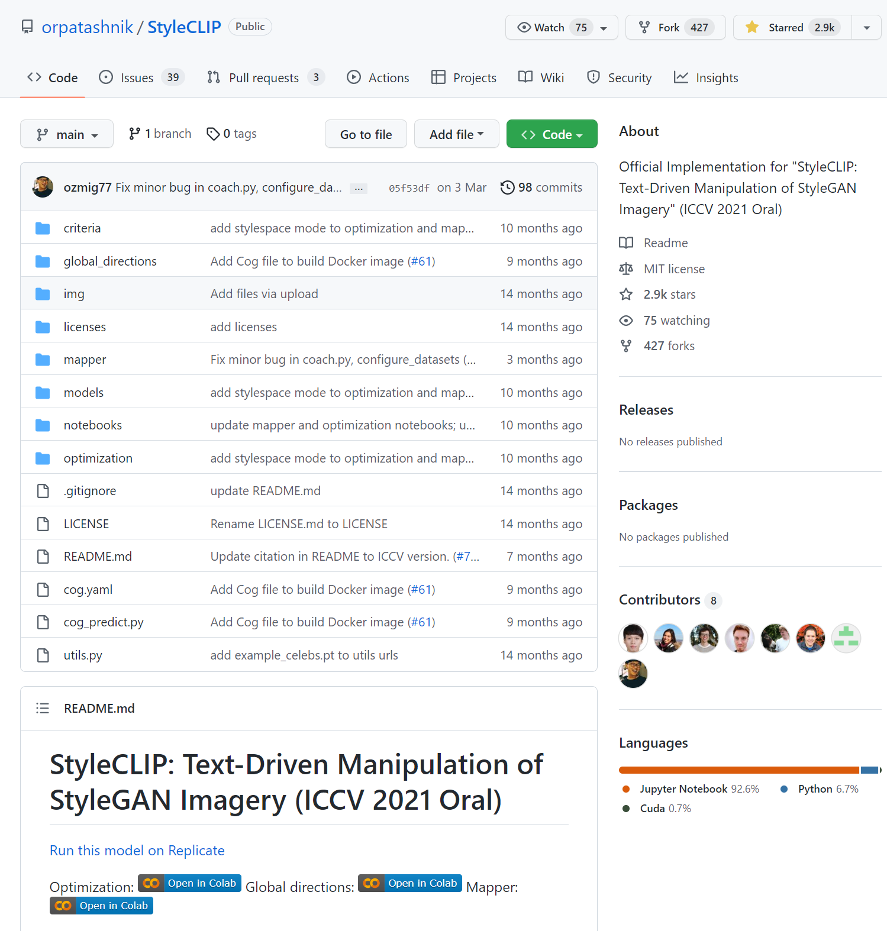
StyleCLIP: Text-Driven Manipulation of StyleGAN Imagery
https://arxiv.org/pdf/2103.17249.pdf
https://github.com/orpatashnik/StyleCLIP

Slide 13
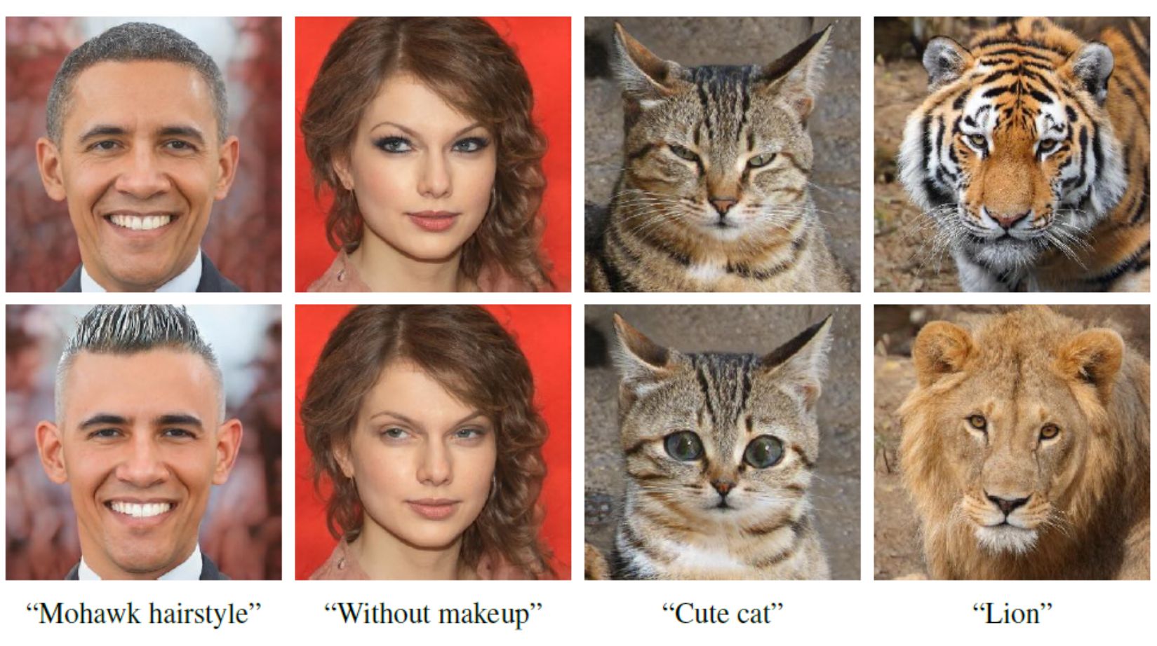

Slide 14
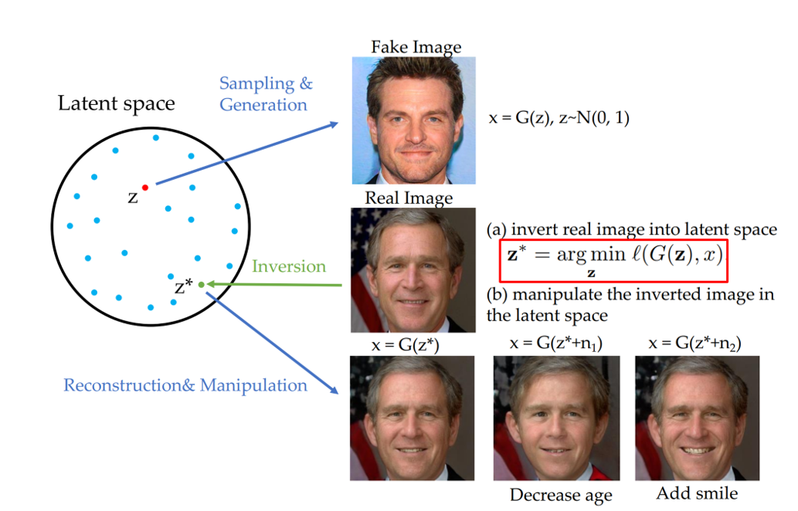
Remind: GAN Inversion an Editing

Slide 15
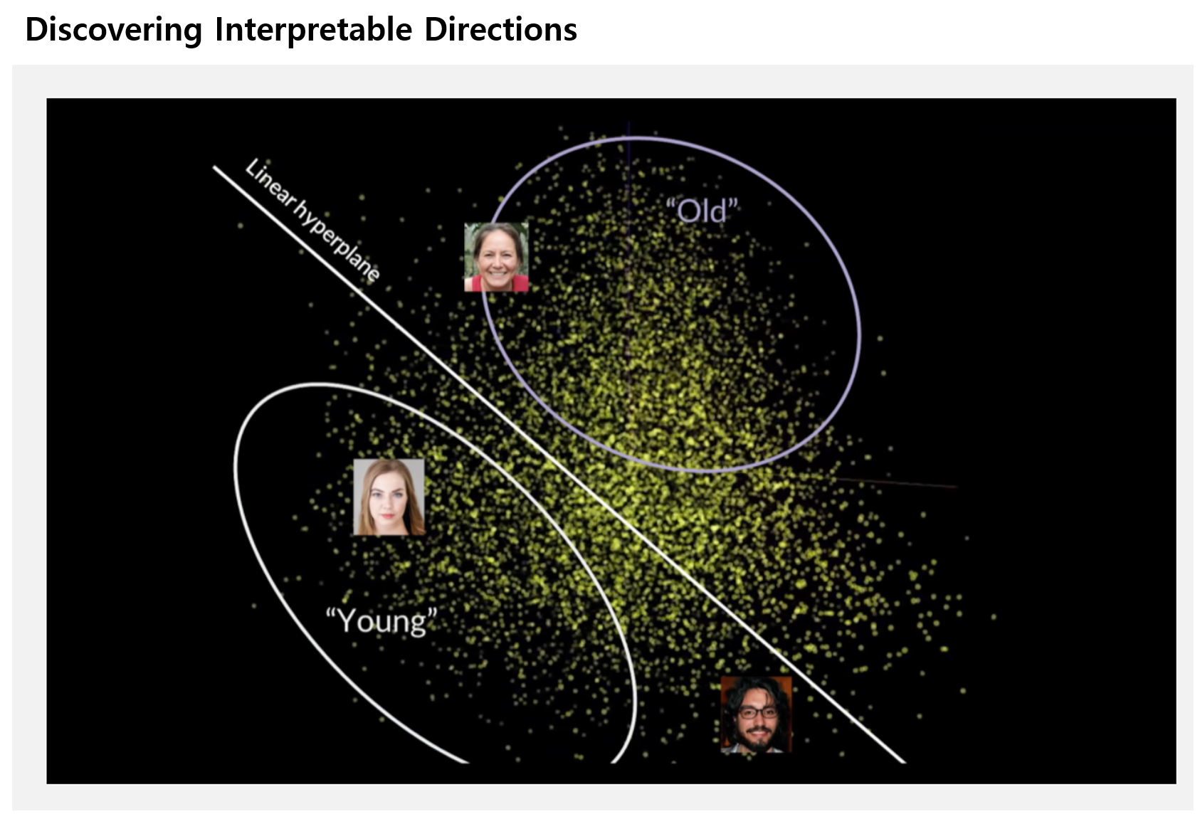
Remind: GAN Inversion an Editing

Slide 16
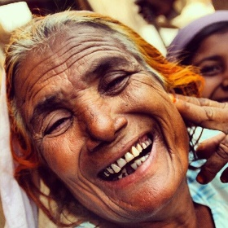
smile
sad
makeup
A photo of a
{attribute} face
depressed
A photo of a
smile face

Slide 17
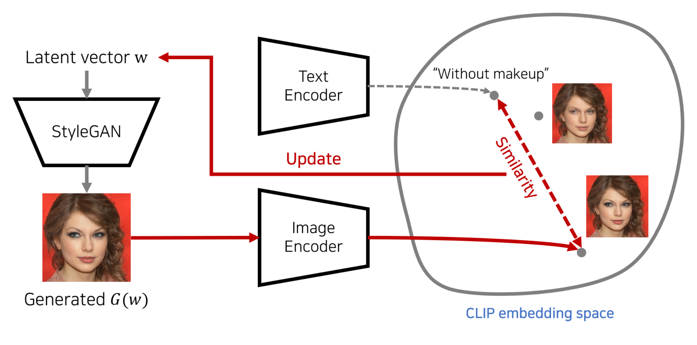
https://github.com/ndb796/StyleCLIP-Tutorial

Slide 18
